Slide 1
Attendance Procedures for First Week of School
Thursday, September 3, 2020
Federal State and Compliance
Sr. Manager, Wanda Thomas

Slide 2
Norms
Please mute your microphone and camera during the presentation.
Place your questions in the chat.
Raise your hand and we will call you at the end of the presentation if we have not addressed your question in the chat.

Slide 3

Agenda:
  Compliance Monitoring Team
  Remote Asynchronous
  Before the First Day
  First Day Procedures
  Membership Microsoft Form
  Second Day and any day thereafter
  No-Show Process
  Reports
  Membership Transaction Log

Slide 4
Compliance Monitoring Team
This team reviews manual / data for Discipline and PEIMS Leavers/Dropouts, collaborates with special populations departments to ensure data integrity, conducts training and assists the State Reporting Team by overseeing the campus data correction process. In addition, they manage four Sr. Student Information Representatives.
Email | Senior Compliance Analyst | Sr. Student Information Rep
Heidi.Cisneros@houstonisd.org | Heidi Cisneros | Elizabeth Salazar/Lisa Shannon/Patricia Marshall/Berta Garcia
lsmith3@houstonisd.org | Latonya Smith | Angela Tillmon/Tamika Whitmire/Mechelle Whiting/Marina Tejada
vwinfree@houstonisd.org | Veda Winfree | Mildred Evans/Felicia Freeman/Rose Fuentes/Vacancy

Slide 5
Senior Student Information Representatives
This team monitors official ADA attendance, reviews ADA and OFSDP attendance by 6-week period to ensure the data is accurate, maintains attendance accounting records, reconciles student membership and absences, reviews manual records/data for Discipline and Leavers/Dropouts, and monitors campus PEIMS data to ensure compliance with TEA requirements
Email | Sr. SIR |  | Email | Sr. SIR
mevans7@houstonisd.org | Mildred Evans |  | esalazar@houstonisd.org | Elizabeth Salazar
rfuentes@houstond.org | Rose Fuentes |  | lshanno1@houstonisd.org | Lisa Shannon
pmarshal@houstonisd.org | Patricia Marshall |  | atillmo1@houstonisd.org | Angela Tillmon
ffreeman@houstonisd.org | Felicia Freeman |  | twhitmir@houstonisd.org | Tamika Whitmire
mwhiting@houstonisd.org | Mechelle Whiting |  | mtejada@houstonisd.org | Marina Tejada
bgarcia3@houstonisd.org | Berta Garcia |  | TBD | Vacancy

Slide 6
Elementary Remote Asynchronous Attendance
Teachers will use two attendance codes
Remote Asynchronous Present (RA)
A student who has not met the previous day's attendance requirement through one of the means listed above but did engage in learning and made progress on an assignment can be marked asynchronous present (RA). The teacher must document why they are marking the student asynchronous present. This criterion is only used when updating the previous day's absences. (See slide 17 regarding documentation.)
AT (Absent by Teacher)
Students are present “RA” when… Teams: A student attends a synchronous Teams lesson (Download & save the Teams meeting engagement roster.) or, HUB (LMS): A student engages on the HUB by completing an activity/ assignment in HUB (The curriculum Department has created a short assignment at the beginning of each day's lesson which is an excellent tool to use for attendance purposes.) or, Two-Way Communication: A student engages in a conversation or email exchange with a teacher of record, SPED resource/co-teacher regarding lessons or assignments, or an intervention teacher (cannot be a TA). Teachers who are team teaching should share engagement information to ensure that all students who have engaged are accounted for at the 10:00 A.M. and 2:30 P.M. attendance times.

Slide 7
Secondary Remote Asynchronous Attendance
Teachers will use two attendance codes
Remote Asynchronous Present (RA)
A student who has not met the previous day's attendance requirement through one of the means listed above but did engage in learning and made progress on an assignment can be marked asynchronous present (RA). The teacher must document why they are marking the student asynchronous present. This criterion is only used when updating the previous day's absences. (See slide 17 regarding documentation.)
AT (Absent by Teacher)
Students are present “RA” when… Teams: A student attends a synchronous Teams lesson (Download & save the Teams meeting engagement roster.) or, HUB (LMS): A student engages on the HUB by completing an activity/ assignment in HUB (The curriculum Department has created a short assignment at the beginning of each day's lesson which is an excellent tool to use for attendance purposes.) or, Two-Way Communication: A student engages in a conversation or email exchange with a teacher of record, SPED resource/co-teacher regarding lessons or assignments, or an intervention teacher (cannot be a TA).

Slide 8
Additional Notes
  All instructional interactions used for attendance purposes must be between the student and the teachers of record for the student or a special education teacher who provides services to the student.
  Interactions with office staff, administrators, counselors, etc. do not count as instructional engagement and cannot be used to determine attendance.

Slide 9
Before the First Day
Before the First Day –
Attendance Clerks will distribute via email First Day Attendance Instructions for Teachers, the Membership Microsoft Form Link and Daily Attendance Class Rosters to teachers who do not have access to PowerSchool Teacher Pro. FSC will email attendance clerks and registrars the link and video for the Membership Microsoft Form.

Slide 10
First Day – Tuesday, September 8
First Day of School Tuesday, September 8, 2020, ADA teachers will hold a TEAMS meeting with students in their ADA class period/Homeroom. Teachers will mark a student as Remote Asynchronous present (RA) if by the morning attendance deadline, the student participated in a Teams meeting, completed an assignment in the HUB, or engaged in two-way communication with the teacher via email or phone.
These students will be marked as RA Present and counted in the days Membership.
Students who were not engaged on LMS (HUB), did not interact with the teacher, or did not complete an assignment will be marked as Absent by the teacher. These students will NOT be included in the membership count.
The Remote Leaning Attendance Team will track the receipt of the teachers’ counts and tally class membership count totals for the first 4 days of school. The Remote Learning Attendance Team is the team that the principal has designated to assist the attendance clerk with counting and tallying class membership counts from the Membership Microsoft Form.
    Campus Counts must be posted on the Membership Microsoft Form within times listed below:
Elementary schools must post on or before 10:00 am on the Membership Microsoft Form
Secondary schools must post on or before 11:00 am on the Membership Microsoft Form

Slide 11
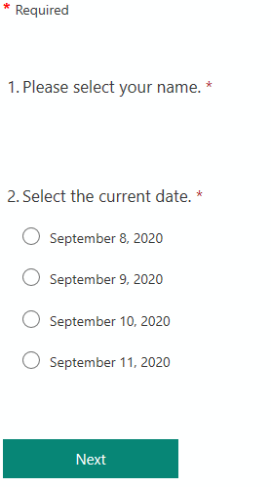
Membership Microsoft Form
(Teachers will complete this form)

Slide 12
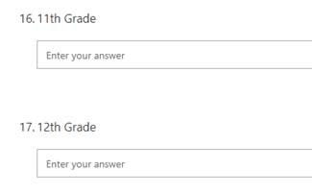
Membership Microsoft Form

Slide 13
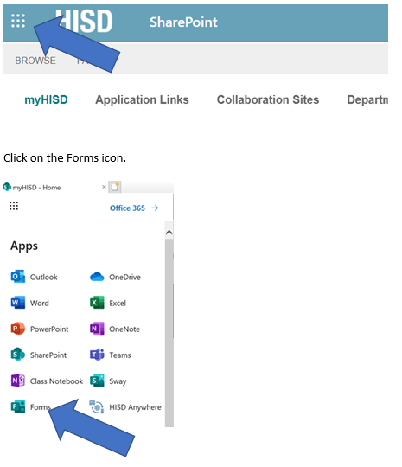
Membership Microsoft Form Access
(please copy and paste the link in your Google Chrome browser)
To access the Microsoft Form you created, you will follow these steps.
Click on the waffle in the upper left-hand corner of the myHISD page.
https://forms.office.com/Pages/ShareFormPage.aspx?id=Zpnr9TaTM0uIlZmCQlsT7Q6iVgT5hWNIh6UWci_HaQtUNEgyNUZJVjFCTUlOM0NBOUQzNlk0NlRCRC4u&sharetoken=8rup09QhlEFvmdQkL9ZM

Slide 14
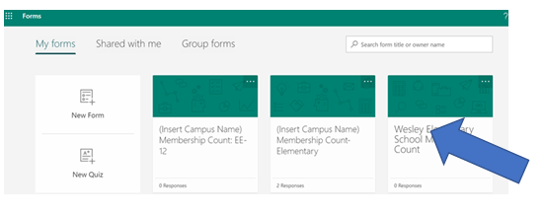

Membership Microsoft Form Access
Click on the Responses tab

Slide 15
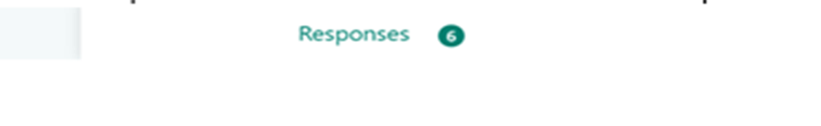
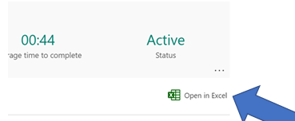
Membership Microsoft Form Access

Slide 16
First Day – Tuesday, September 8 (cont’d)
The campus personnel will ensure/electronic signoff to ensure every teacher has posted to the Membership Microsoft Form and confirmed the membership count prior to posting on the Membership Reporting Application on the HISD Portal.
Attendance Clerk will enter the membership count per grade level for their campus on the Membership Reporting (MSHP). Email membership count to your Sr. SIR if you do not have access to the Membership Reporting Tool.
Numbers must be submitted to Federal and State Compliance by 11:30 am (ES) and 12:30 pm (Secondary)

Slide 17
ADA Attendance Morning Deadline
(submission by ADA Period/HR teacher)
Elementary morning attendance deadline by 10AM
Secondary morning attendance deadline by 11AM

Slide 18
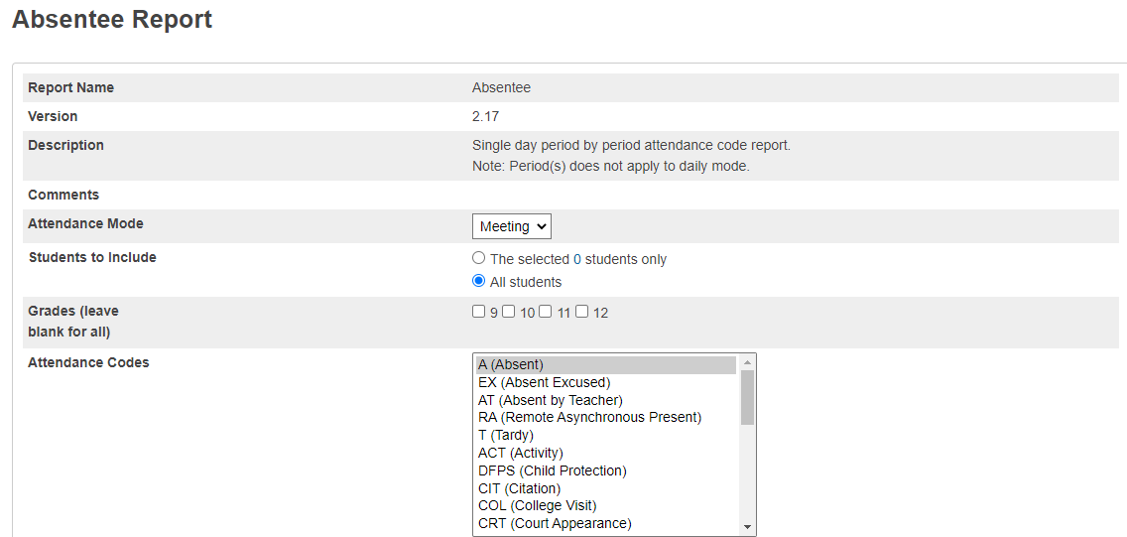
Run Absentee Report
How to run the Absentee Report
Absentee Report shows single day attendance period by period. Elementary campuses can choose Homeroom attendance.
On the Start Page, click Attendance > click Reports Tab > Absentee Report
Use the default setting for Attendance Mode (Meeting)
Select students to include in report (All students)
Select grades to include or leave blank to include all (Leave blank)
For Attendance Codes, select A (Absent) – Use the command or control key to select more than one
Select the period(s) or leave blank for all periods. Keep in mind that there is no need to select a period in Daily mode.
Include the student number, blank lines, and verification line (optional)
Click Submit

Slide 19
ADA Attendance Afternoon Deadline
(submission by ADA Period/HR teacher)
    Elementary afternoon attendance updated by 2:30PM
    Secondary afternoon attendance updated by 3:30PM

Slide 20
PowerTeacher Attendance and Teacher Submission Status Reports
The clerk should run the PowerTeacher Attendance Report or the Teacher Submission Status Report. Both reports show which teachers have not taken attendance.
If teachers have not posted attendance clerks should send a reminder email to the teacher within 20 minutes after ADA time.

Slide 21
Evening Attendance Callout
Elementary - Automated call out reminder for all students who were marked absent in their homeroom at Afternoon Attendance Deadline to complete assignments for attendance purposes.
Secondary - Automated call out reminder for all students who were marked absent in their ADA period at Afternoon Attendance Deadline to complete assignments for attendance purposes.

Slide 22
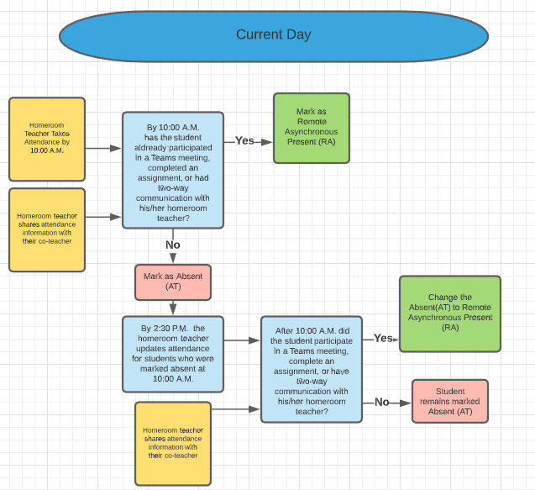
Elementary Attendance Cycle

Slide 23
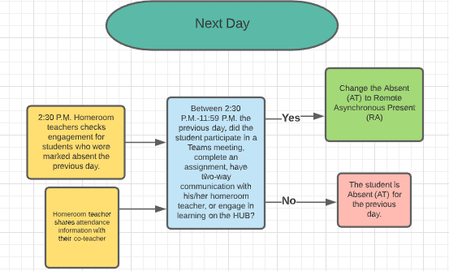
Elementary Attendance Cycle

Slide 24
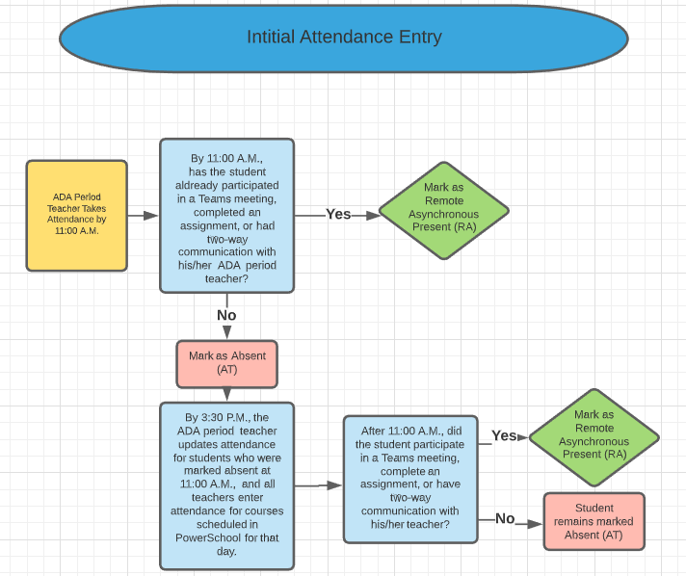
Secondary Attendance Cycle

Slide 25
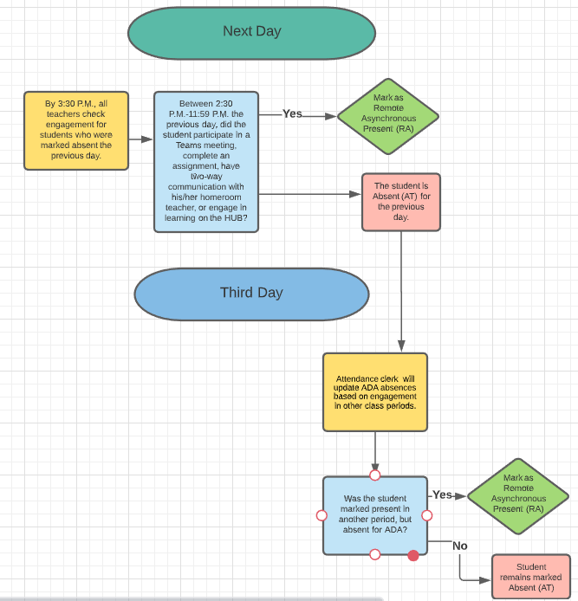
Secondary Attendance Cycle

Slide 26
Second Day and any Day Thereafter
Wednesday, September 9, 2020 through Friday, October 16, 2020
Daily attendance will be verified based on student engagement as noted above.

Slide 27
Day After Attendance Locks
Run the Absentee Report
Make corrections to the ADA period for students who were absent for the ADA period but engaged in another class on the same day.
The clerk should run this report to ensure phone calls are made to all students.10:01am – 2:29pm.

Slide 28
Membership Count Process
Membership and attendance should be posted, verified and reconciled daily.

Slide 29
Membership on the Portal
    Elementary reporting time on/before by 10AM
    Secondary reporting time on/before by 11AM

Slide 30
No-Show Process on Friday, September 11, 2020
No Show Process on Friday, September 11, 2020
Students will be marked as No Show if students were marked absent every day this week.
Any student marked AT (Absent by Teacher) and RA present will not be marked as a No Show. In Power School the student’s enrollment date MUST match the FIRST day the student was marked RA Present. This will need to be corrected by the clerk.
All No Shows must be posted by the end of the day on Friday, September 11, 2020.
All No Shows will have an effective date in PowerSchool of September 8, 2020.
Attendance Clerks will run the Weekly Attendance Summary (Daily) and verify which students have been marked absent every day and enter a No Show on their enrollment page via the Transfer Out Process. See instructions below.

Slide 31
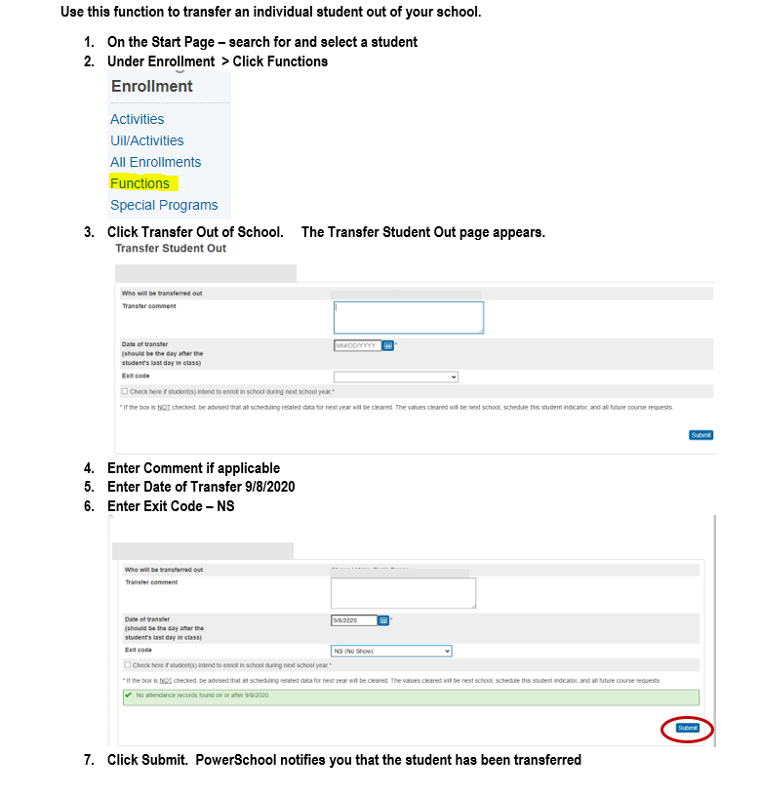
No-Show Process on Friday, September 11, 2020
Follow these instructions to No Show students

Slide 32
Weekly Summary Report
How to run the Weekly Attendance Summary Report
Weekly Attendance Summary is weekly attendance summary by section. There are two versions of the report: Daily and Meeting. Select the one that corresponds with your school’s attendance mode.
On the Start Page, click System Reports
Click Weekly Attendance Summary (Daily/Meeting)
Choose a week
Choose which teacher(s) to run the report for, or choose All Teachers
In the Attendance Codes section at the bottom of the report setup page, fill in all the codes in the Absent field that the school uses to indicate that a student has an excused absence
Fill in all the codes that count as unexcused absences and as tardies in their respective fields
Check Include Verification Line
If you plan to run this report routinely and want the values you set to be the default values (so you don’t have to reset them every time), select the boxes on the right side of the page for each value that you want to save
Click Submit

Slide 33
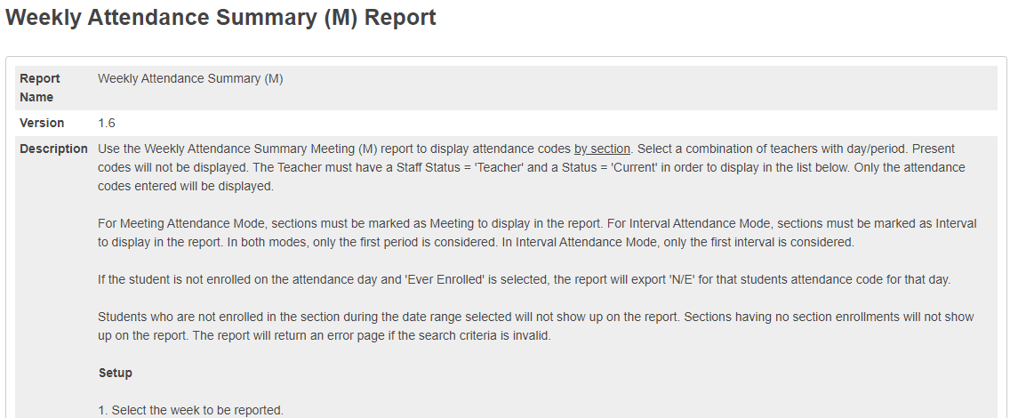
Weekly Summary Report (cont’d)

Slide 34
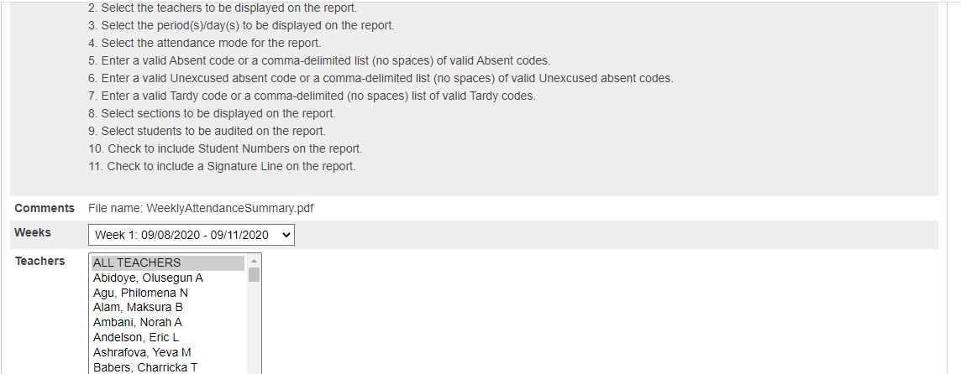
Weekly Summary Report (cont’d)

Slide 35
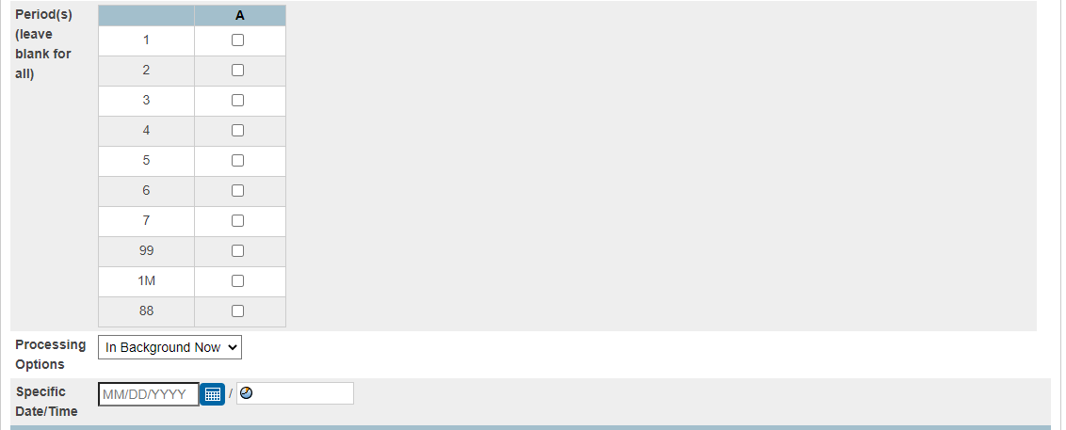
Weekly Summary Report (cont’d)

Slide 36
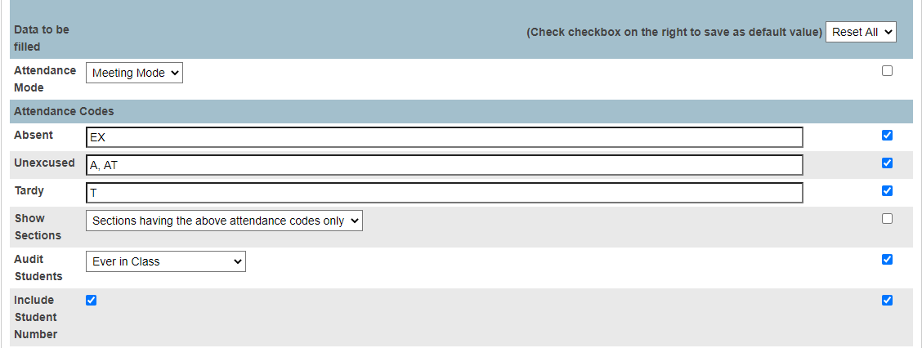
Weekly Summary Report (cont’d)

Slide 37
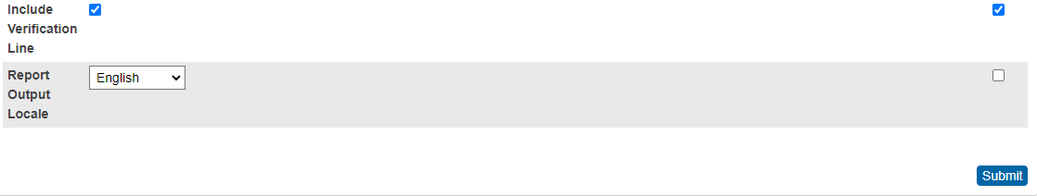
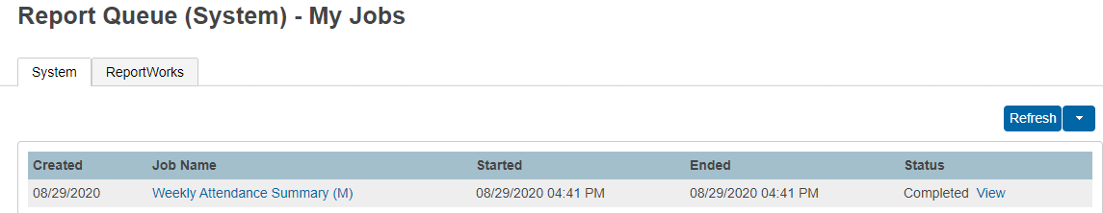
Weekly Summary Report (cont’d)

Slide 38
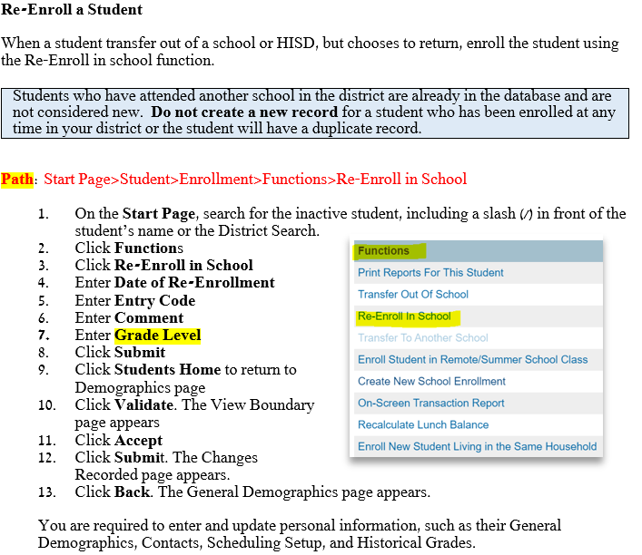
Re-enroll a Student

Slide 39
No-Show Verification Process
Beginning Monday September 14, 2020
No-Show Verification Processes – Remote Learning Attendance Team
Beginning Monday September 14, 2020, the team will conduct the verification process to ensure all identified students were purged from PowerSchool.
Generate the Search-Student Entry/Exit Summary report
PEIMS Coordinator will sign off on verification report

Slide 40
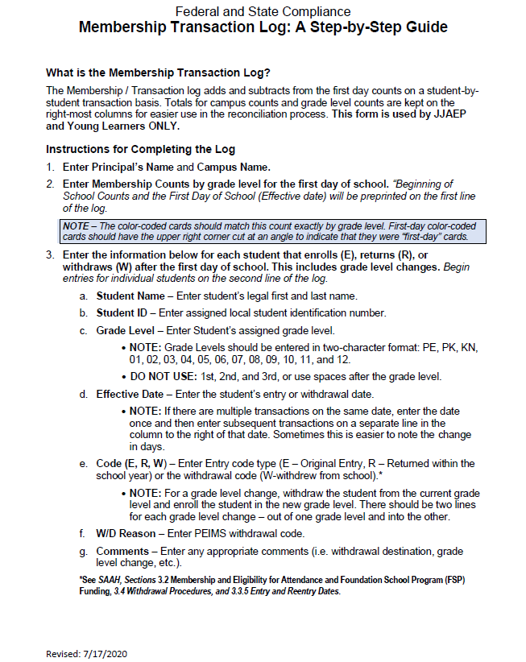
Membership Transaction Log

Slide 41
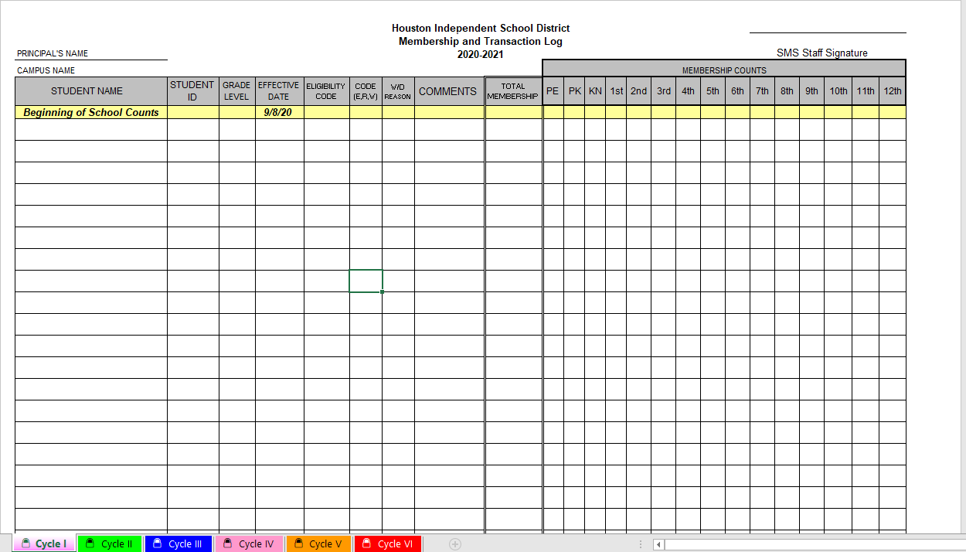
Membership Transaction Log:
No Color-Coded Cards during Asynchronous Instruction

Slide 42
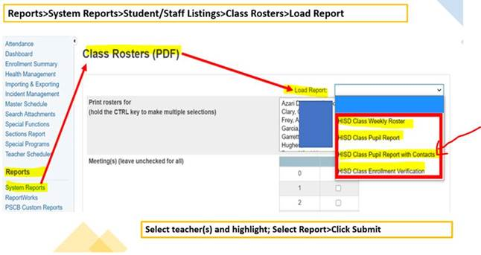
Home Roster/Class Roster
District Reports > Scheduling > Class Roster Auto Loader >

Slide 43
Teacher Attendance Submission Status Report
How to view the Teacher Attendance Submission Status Report
View the Teacher Attendance Submission Status report from the Attendance dashboard by either clicking the "i" icon on the Meeting tab, or by clicking the Reports tab.
1. On the Start Page, click Attendance
2. Click the Reports tab
3. Click Teacher Attendance Submission Status
4. Review ADA period or all periods
    Order By - This sort the list according to your selection
    Show – View the status of teachers according to your selection
5. Click a teacher’s name to see a list of the teacher’s classes
and the attendance status for each class
6. Click Ok to close the window
7. View the progress indicators to determine which teachers have or have not submitted attendance information
    A green highlight with a check mark means that the teacher has submitted attendance for all classes
    A yellow highlight with an exclamation point means that the teacher has submitted attendance for only some of his or her classes
    A red highlight with an exclamation point means that the teacher has not submitted attendance for any classes

Slide 44
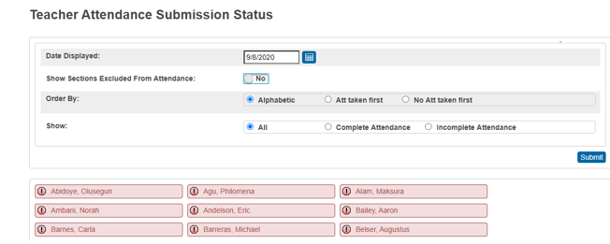
Teacher Attendance Submission Status Report

Slide 45
PowerTeacher Attendance Report
PowerTeacher Attendance report or Teacher Attendance Submission Status reports both show which teacher have not taken attendance.
How to run the Power Teacher Attendance Report:
On the Start Page under the Functions section, click Attendance
Click the Reports tab
Click PowerTeacher Attendance
Enter a Date to Scan
Select the appropriate period check box, such as 2, or leave the check boxes blank to run the report for all periods
Use the default values for the rest of the settings and click Submit
On the "Report Queue (System) – My Jobs" page, click Refresh until the status changes to completed
When the status says Completed, click View. You may also right click View to open the report in a new tab
Teachers who have not taken attendance during second period are listed
Click a teacher’s name to email that person, or click a period to view more information about the course

Slide 46
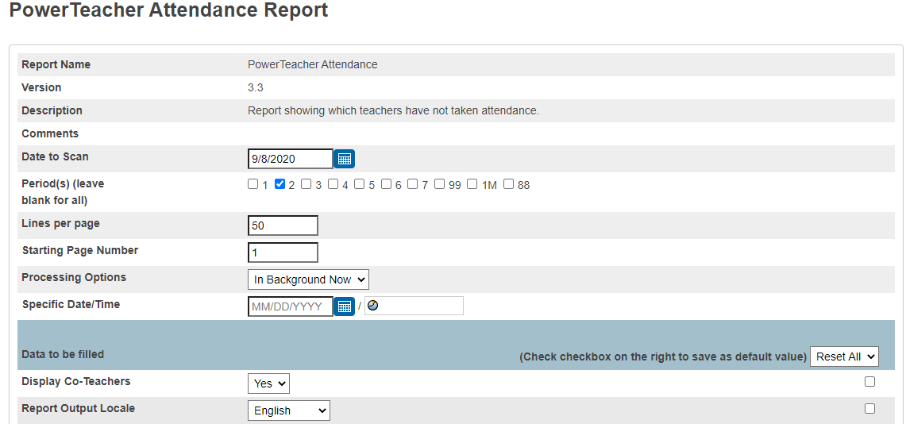
PowerTeacher Attendance Report (cont’d)

Slide 47
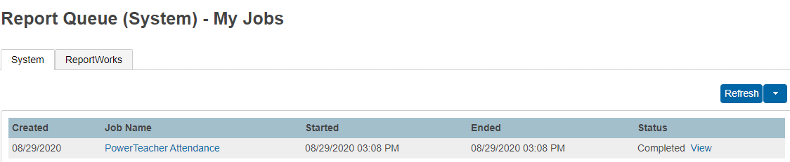
PowerTeacher Attendance Report (cont’d)

Slide 48
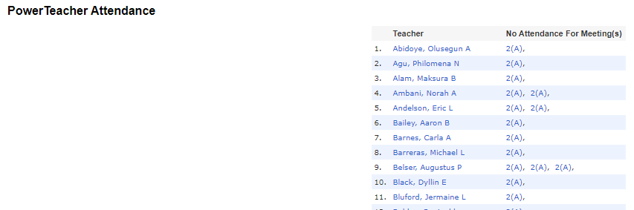
PowerTeacher Attendance Report (cont’d)

Slide 49
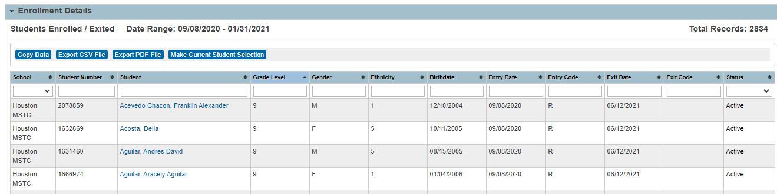
Search-Student Entry/Exit Summary Report
Search-Student Entry/Exit Summary Report
Search student enrollments for entries and exits within a selected date range.
On left side of the Start Page under Reports heading, select District Reports.
Under Registration and Enrollment section, select Search-Student Entry/Exit Summary.
Click Submit
Click on the up and down arrows on right side of the Grade Level heading to sort by grade levels.
Choose one of the output options to print report.

Slide 50
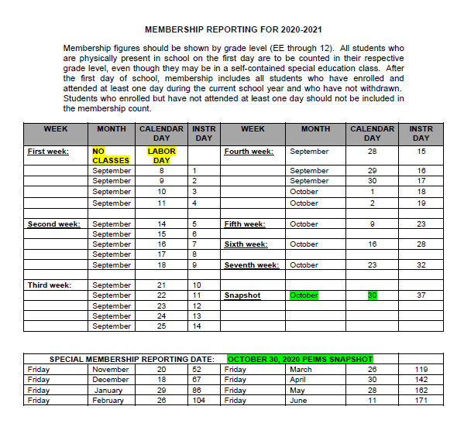
Membership Reporting
Membership figures should be shown by grade level (EE through 12). All students who are physically present in school on the first day are to be counted in their respective grade level, even though they may be in a self-contained special education class.
After the first day of school, membership includes all students who have enrolled and attended at least one day during the current school year and who have not withdrawn. Students who enrolled but have not attended at least one day should not be included in the membership count.

Slide 51
Friendly Reminder
Friendly Reminder
Membership Reporting
Due by 10:30am via HISD Portal
If you do not have access to membership on the portal, please enter your campus name, campus # and membership figures in the table below. Please include ALL students in membership on the portal including NON -ADA students.
Tuesday, September 8, 2020

Slide 52
Questions???

